Slide 1
PROJECTIONS
OF
LINES

Slide 2
PROJECTIONS OF LINES
Definition of line:
A straight line is the shortest distance between two points.
Top views of two end points of a straight line, when joined, give the top view of the straight line.
Front views of the two end points of a straight line, when joined, give the front view of the straight line.
Both the above projections are straight lines.

Slide 3
Orientation of Straight Line in Space
A line in space may be parallel, perpendicular or inclined to either the H.P. or V.P. or both.
It may be in one or both the reference Planes.
Line ends may be in different Quadrants.
Position of Straight Line in space can be fixed by various combinations of data like distance of its end points from reference planes, inclinations of the line with the reference planes, distance between end projectors of the line etc.

Slide 4
Notations used for Line
True length of the line:
Denoted by Capital letters. e.g. AB=100 mm, means that true length of the line is 100 mm.
Front View Length:
Denoted by small letters. e.g. a’b’=70 mm, means that Front View Length is 70 mm.
Top View Length:
Denoted by small letters. e.g. ab=80 mm, means that Top View Length is 80 mm.
Inclination of True Length of Line with H.P.:
It is denoted by θ. e.g. Inclination of the line with H.P. (or Ground) is given as 30º means that θ = 30º.

Slide 5
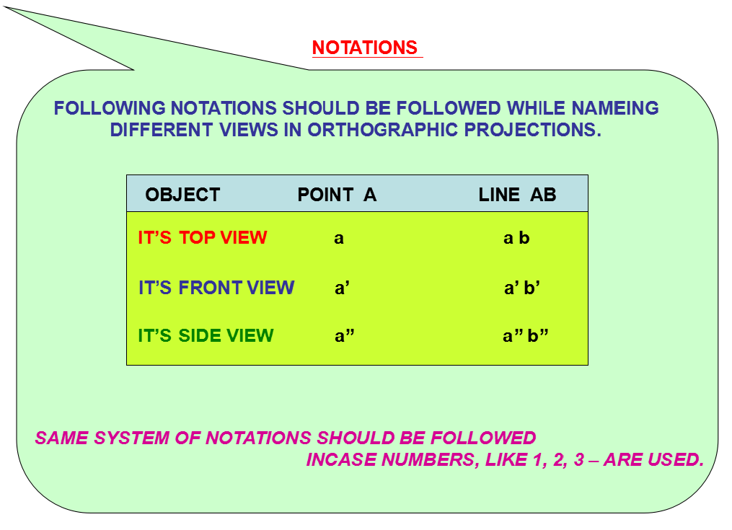

Slide 6
Inclination of True Length of Line with V.P.:
It is denoted by Φ. e.g. Inclination of the line with V.P. is given as 40º means that Φ = 40º.
Inclination of Front View Length with XY :
It is denoted by α. e.g. Inclination of the Front View of the line with XY is given as 50º means that α = 50º.
Inclination of Top View Length with XY :
It is denoted by β. e.g. Inclination of the Top View of the line with XY is given as 30º means that β = 30º.
End Projector Distance: (DBEP)
It is the distance between two projectors passing through end points of F.V. & T.V. measured parallel to XY line.

Slide 7
Line in Different Positions with respect to H.P. & V.P.
CLASS A: Line perpendicular to (or in) one reference plane & hence parallel to both the other planes
Line perpendicular to P.P. & (hence) parallel
to both H.P. & V.P.
(2) Line perpendicular to V.P. & (hence) parallel
to both H.P. & P.P.
(3) Line perpendicular to H.P. & (hence) parallel
to both V.P. & P.P.

Slide 8
Line in Different Positions with respect to H.P. & V.P.
CLASS B: Line parallel to (or in) one reference plane & inclined to other two planes
Line parallel to ( or in) V.P. & inclined to H.P.
by .
(2) Line parallel to ( or in) H.P. & inclined to V.P.
by .
(3) Line parallel to ( or in) P.P. & inclined to H.P.
by  & V.P. by .

Slide 9
Line in Different Positions with respect to H.P. & V.P.
CLASS C: Line inclined to all three reference planes ( Oblique lines )
Line inclined to H.P. by , to V.P. by  and also inclined to profile plane.

Slide 10
Class A(1) : Line perpendicular to P.P. & hence parallel to both the other planes
Y
V.P.
b’
a”
.
P.P.
a’
b”
B
Y
A
X
b
H.P.
a
z
x

Slide 11
Class A(1) : Line perpendicular to P.P. & hence parallel to both the other planes
V.P.
b
a
Y
X
b’
a’
H.P.

Slide 12
P.P.
a”, b”
.
V.P.
b’
Y₁
a’
Y
X
b
a
H.P.
Class A(1) : Line perpendicular to P.P. & hence parallel to both the other planes

Slide 13
a’
b’
a”, b”
.
F.V.
L.H.S.V.
X
Y₁
Y
a
T.V.
b
Class A(1) : Line perpendicular to P.P. & hence parallel to both the other planes

Slide 14
Exercise 1 :- A Line AB, 50mm long is perpendicular to the profile plane. The end A is 20mm below H.P. , 30mm behind V.P. & 10mm to the left of P.P. Draw the projections of straight line AB (i.e. Front View & Top View).
Data given :-
Y₁
50
T.L. = 50mm
.
a
Profile Plane
b
.
20 below H.P.
(2)Point A
T.V.=T.L.
30mm Behind V.P.
30
Line is perpendicular
to P.P.
10
X
Y
Line is 10mm left of
P.P.
.
20
.
b’
F.V.=T.L.
a’
Y₁
Scale :- 1:1

Slide 15
Y
V.P.
a’, b’
.
A
Y
B
a
X
H.P.
b
X
Class A(2):Line perpendicular to V.P. & (hence) parallel to both the other Planes
(i.e. H.P. & P.P.)

Slide 16
Class A(2):Line perpendicular to V.P. & (hence) parallel to both the other Planes
V.P.
a’, b’
.
Y
a
X
b
H.P.

Slide 17
Class A(2):Line perpendicular to V.P. & (hence)
parallel to both the other Planes
V.P.
a’, b’
.
F.V.
X
Y
a
T.V.
b
H.P.

Slide 18
Exercise 2 :- A Line ABC, 80mm long is perpendicular to V.P & 50mm below H.P. Point B, 20mm from A is on V.P. A is in 4th quadrant. Draw the projections of line ABC.
.
Data given :-
c
T.L. = 80mm
60
(2) AB = 20, BC = 60
.
(3) Point B is in V.P.
X
Y
b
Line is 50mm below H.P.
20
.
50
- Point A is in 4th quadrant
a
.
a’,b’,c’
- Line is perpendicular to V.P.
Scale :- 1:1

Slide 19
Y
V.P.
b’
B
Y
a’
A
X
.
H.P.
a,b
X
Class A(3):Line perpendicular to H.P. & (hence) parallel to both the other Planes

Slide 20
Class A(3):Line perpendicular to H.P. & (hence) parallel to both the other Planes
V.P.
b’
Y
a’
X
.
a,b
H.P.

Slide 21
Class A(3):Line perpendicular to H.P. & (hence) parallel to both the other Planes
a’
V.P.
b’
X
Y
.
a, b
H.P.

Slide 22
Exercise 3:- A Line AB, 50mm long is perpendicular to H.P. & it is below H.P. Point A is on H.P. & 30mm behind V.P. Draw the projections of the line AB.
Data given :-
.
a,b
T.L. = 50mm
30
On H.P.
(2) Point A
30mm Behind
V.P.
X
.
Y
a’
(3) Line is perpendicular
to H.P.
50
F.V.=T.L.
b’
.
Scale :- 1:1

Slide 23
Class B(1): Line contained by ( or parallel to) V.P. & inclined to H.P. by 
Y
V.P.
B
b’
θ
b
Y
A
a’
a
X
H.P.
X

Slide 24
Class B(1): Line contained by ( or parallel to) V.P. & inclined to H.P. by 
V.P.
b’
θ
Y
a’
b
a
X
H.P.

Slide 25
Class B(1): Line contained by ( or parallel to) V.P. & inclined to H.P. by 
V.P.
b’
a’
θ
a
b
X
Y
V.P.

Slide 26
Exercise 4 :- A Line AB, 75mm long, is in V.P. It makes an angle of 30º with the H.P. Point A is 20mm above H.P. Draw the projections of line AB.
b’
Data given :-
F.V.=T.L.
T.L. = 75mm
.
(2)  = 30º
a’
==30º
(3)Point A = 20mm above H.P.
20
.
a
b
X
Y
T.V.
- Line AB is in V.P.
Scale :- 1:1

Slide 27
Class B(2) : Line parallel to (or contained by) H.P. & inclined to V.P. by 
Y
V.P.
V.P.
b’
a’
b’
a’
A
ø
B
Y
X
Y
β
X
a
b
H.P.
a
β=φ
X
b
H.P.

Slide 28
Class B(3): Line parallel to (or contained by) P.P., inclined to H.P. by  & to V.P. by 
Y
V.P.
a”
P.P.
a’
☞
A
Y

☞
b”
b’

B
H.P.
X
a
b
X
Z

Slide 29
Class B(3): Line parallel to (or contained by) P.P., inclined to H.P. by  & to V.P. by 
V.P.
a”
P.P.
a’
☞
b’

b”
X
Y
a
b
H.P.

Slide 30
Exercise 5 :- The distance between the end projectors of line MN is zero. Point M is 40 mm below H.P. & 25 mm behind V.P. Point N is 15 mm below H.P. & 65 mm behind V.P. Draw its projections and find the angle of the line with H.P. and V.P. Also find the true length of the line.
.
Data given :-
40 below H.P.
n
(1) Point M
25 mm behind V.P.
T.V.
.
m
15 below H.P.
65
(2) Point N
65 mm behind V.P.
25
45
Y
X
(3) End projector dist. = 0
.
.
15
n’
n”
40

F.V.
☞
.
.
T.L.
m’
m”

Slide 31
Class C:Line inclined to H.P. by  & V.P. by  ( i.e. Line inclined to both the planes)
Y
V.P.
b’
B
Y

a’
A

X
a
b
H.P.
X

Slide 32
Class C:Line inclined to H.P. by  & V.P. by  ( i.e. Line inclined to both the planes)
V.P.
b’
Y

a’
X

a
b
H.P.

Slide 33
Class C:Line inclined to H.P. by  & V.P. by  ( i.e. Line inclined to both the planes)
V.P.
b’
a’

X
Y
a

b
H.P.

Slide 34
Exercise 6:- A Line AB, 90 mm long, is inclined to H.P. by 30° and inclined to V.P. by 45º. The line is in first quadrant with Point A 15 mm above H.P. and 25 mm in front of V.P. Draw the projection of line AB.
Locus of b’
b’
b₁’
Data Given :-
T.L.= 90
(1) T.L.=90 mm
F.V.
(2) Θ =30°
.
α
a’
θ
(3) Φ =45°
15
b₂’
15 above H.P.
Y
X
(4) Point A
25 mm in Front of V.P.
25
.
b₁
a
Φ
Answers :-
β
(1) F.V.= 64 mm
T.V.
(2) T.V = 78 mm
b₂
Locus of b
(3)  = 45°
(4)  = 55°
b

Slide 35
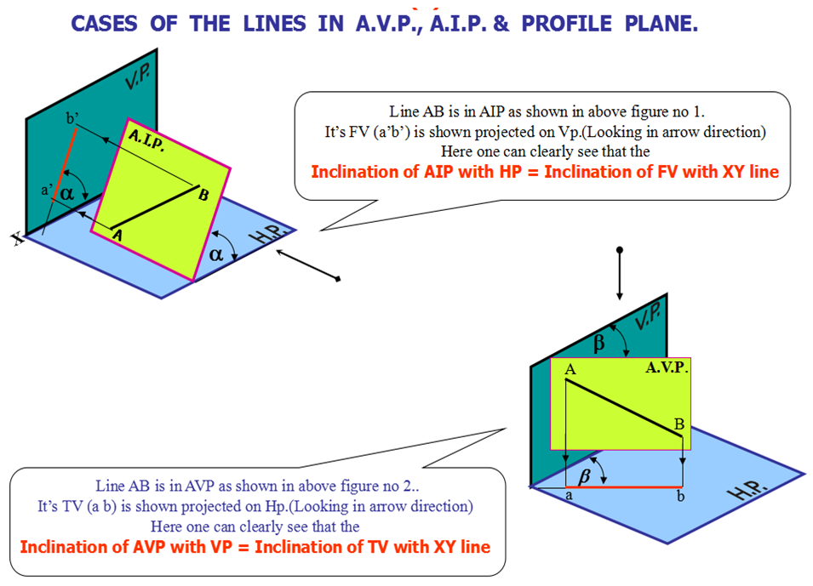

Slide 36
Laboratory Questions
Q-1. An 80 mm long line PQ has its end P on the HP and 15 mm in front of the VP. The line is inclined at 30 ° to the HP and its top view is inclined at 60 ° to the reference line. Draw the projections of line PQ and determine true angle of inclination with the VP.

Slide 37
Laboratory Questions
Q-2. The front view of straight line AB is 60 mm long and is inclined at 60° to the HP. The end point A is 15 mm above HP and 20 mm in front of VP. Draw the projections of line AB if it is inclined at 45° to VP and is in 1st quadrant. Determine true length and inclination with HP.

Slide 38
Laboratory Questions
Q-3. A line AB, 80 mm long, makes an angle of 30° with the VP and lies in a plane perpendicular to both HP and VP. Its end A is in the HP and the end B is in VP. Draw projections of line.

Slide 39
Laboratory Questions
Q-4. The midpoint of a line AB measuring 80 mm is 50 mm above HP and 30 mm in front of VP. The line is inclined at 45 ° to HP and 30 ° to VP. Draw the projections and find the length of plan and elevation.

Slide 40
Thank
You

